Slide 1
Diagrams and Graphs

Slide 2
CONTENTS (for diagram descriptions see here)
1 Wealth increase
2 Land v Building value
3 Ways of getting rich
4 What happens when infrastructure/railway is built?
5 Robots
6 Regional Effects
7 Wealth and income inequality linked to health problems
8 Ten Key issues which we are trying to tackle Monopolies
9 Monopolies
10 Key environmental issues
11 Successful environmental initiatives
12 Taxes Affect
13 How export/import intensive different industries are
14 Border tax adjustments for carbon tax
15 How high carbon tax needs to be (McKinsey cost curve)
16 Jobs at Risk of Robotisation infographic
17 Drivers of job losses
18 Poverty Trap
19 Whack-a-mole
20 Progression of land value increase
21 Income flow chart

Slide 3
NEW DIAGRAMS
Effect of Increasing Returns to Scale
Effect of economic activity (similar to the land value increase slide)
Capture of land value increase through land value tax or land value tax increments or prepurchase of land by the government

Slide 4
Neoclassical Assumptions (1): Economies of Scale
A free market economy and without a significant state sector is supported by neoclassical economic theory. This theory has the following assumptions often built into it:
Decreasing returns to scale. This assumption is that as a company get bigger their efficiency in producing something declines. If this assumption is true, then it is natural that a system of competitive market system will evolve. There’ll be many more firms competing with one another. Profit margins for each company will be small. Minimal government intervention is required.
Alternative assumption is increasing returns to scale. If this is true, then larger companies will out compete smaller companies.
Eventually, each market is dominated by a few players. These players will corner the market, charging higher prices and stifling innovation.
Note that in this case, competition isn’t entirely absent. However, it’s likely that the major new entrants will have to be themselves quite large and capable of establish its market in a small region or subsector and then expand. For example, Amazon started with delivering with books and had large venture capital behind it. Uber also has large backing and investors that are willing to suffer large losses; furthermore, a taxi firm can establish itself in a local market just for rolling out the service world wide. Ultimately, both are in search of global monopoly. This is potentially problematic if it reduces diversity of provision and ultimately, monopoly can increase prices.

Slide 5
More Neoclassical Assumptions
Most value is private value (created by companies) as opposed to public or social value.
Externalities are small
The public sector or government can behave in an optimal fashion
Products are not differentiated as to be possible to analyse
What matters is preference satisfaction, other human values can be rolled up into this general statement
Preference satisfaction is achieved through consuming products, not through working

Slide 6
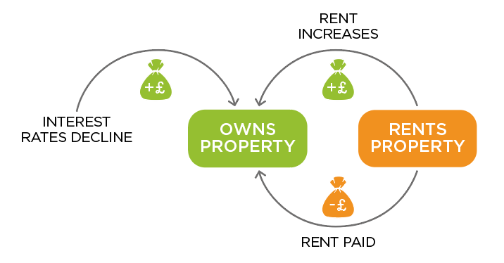
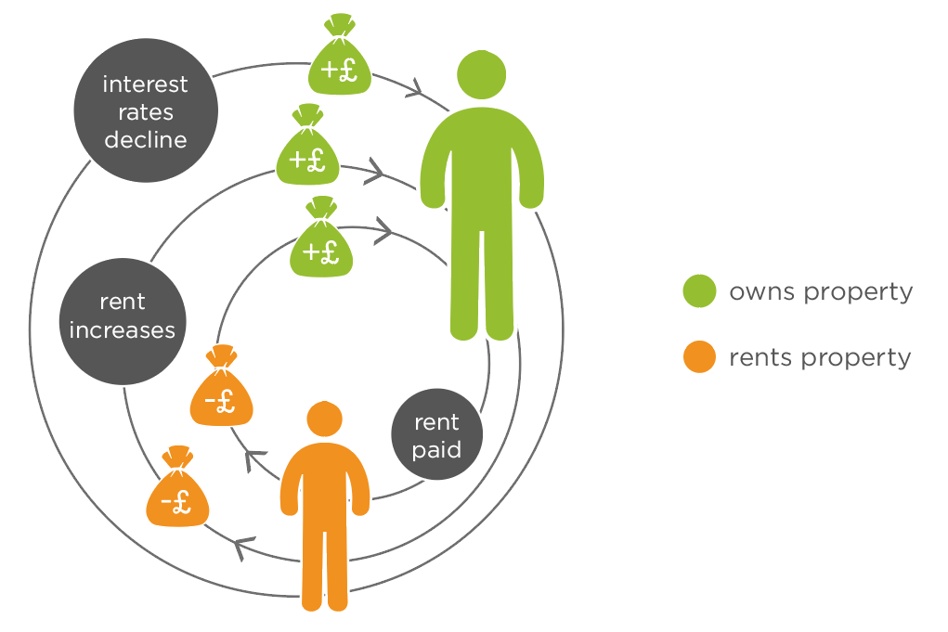
1 Wealth increase
Selvin’s comment: I think the graph makes sense but will take the viewer a little time to study and decipher - not at first glance. It may make it less confusing if the ‘rent paid’ circle was moved into the space between the 2 money bags (though less visually balanced).
Jo: is this better?
Notes:
1.DIAGRAM -- wealth increase,
Arrow circle: some people own property; others don’t. Those that don’t pay rent. If the rent goes up, that's a transfer from the have nots to the haves. And if the interest rate declines, then that increases the capital value of houses.
Comment:
I still find this diagram a bit confusing to be honest. It’s not clear what it is trying to show.
It would be better shown perhaps as a diagram of the whole system.
E.g. A system diagram

Slide 7

2 Land v Building value
Comments: This diagram is showing:
I think it’s clear/not clear
Ways it could be improved:
Selvin’s comment: Looks good and makes sense. Probably difficult to also incorporate the concept of ‘real’ value into this piece of infographics
Jo: I considered showing deeper land under the London property but thought it would give the impression of more land rather than higher value land.
Notes:
2. Land v Building value image
Cartoon of two identical houses (possibly ‘Monopoly’ houses?), on land. One in London. The other in Scunthorpe. Comparing the value of the houses (the same) with the value of the land underneath (very different).
Comments:
Would this work if the land value was shown as a ‘deep’ bit of land ie as a sort of pictorial bar chart? Should we use ‘real’ values? Ie the values in London or Scunthorpe?

Slide 8
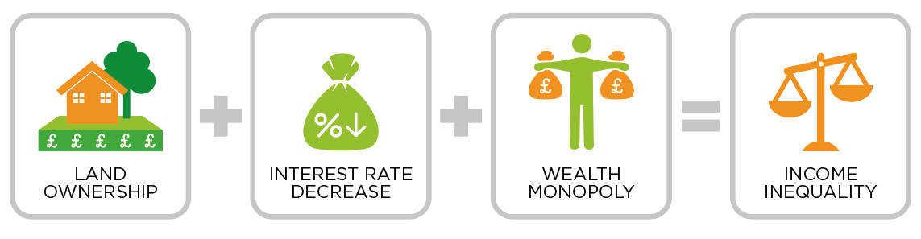
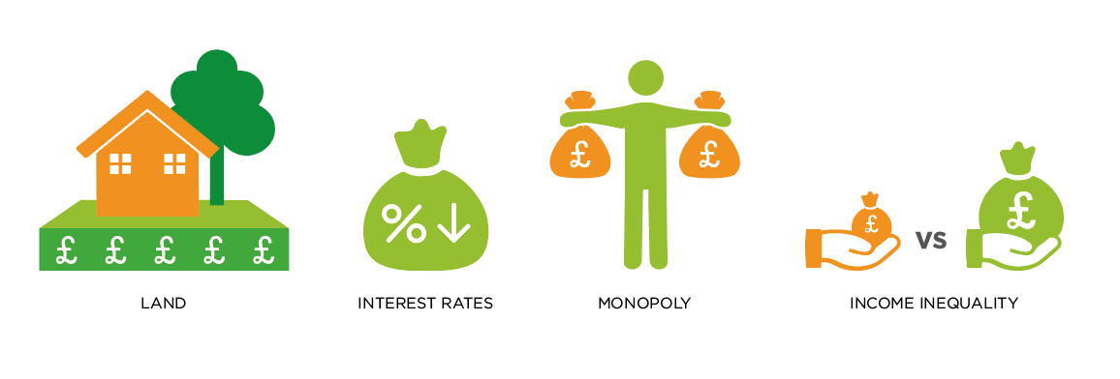
3 Ways of getting rich
Selvin’s comment: All the illustrations for depicting the drivers of wealth inequality is here, but just need some way to demonstrate the movement of those drivers leading to inequality. Perhaps some simple plus and equal signs?
Eg. Land + Interest Rates decrease + monopoly = income inequality. Alternatively, colour coding of orange and green may be another option?
Notes:
3. Ways of getting rich
Key Drivers of Wealth Inequality, with explanation
LAND (picture of a house on land)
INTEREST RATES (percentage sign and arrow going down)
MONOPOLY (monopoly man character)
INCOME INEQUALITY (image of cash perhaps?)
Comments:
Is the monopolist diagram very clear? What is it trying to show? In no cases are there ‘systems’ diagrams.
Jo: please be specific in the diagram descriptions, i.e. please ask for a systems diagram if one is required

Slide 9
4 What happens when infrastructure/railway is built?
Notes:
4. What happens when infrastructure/railway is built?
Image
House on land -- railway comes in ---- same house on land as much higher land value
Purpose
This diagram (or set of diagrams) illustrate unearned increases in land value when new infrastructure is built. It might work best as a series of diagrams - for example, when a new piece of infrastructure is built such as a metro line, the land value near the metro line increases. One sequence that would show this would be first some houses without metro stop; then the addition of the new metro stop and an increase in land value for the houses and other buildings concerned.
4b. Capture of land values
Could also show how HK does it purchase of land by metro company, and how you could do it with Incremental LVT
Descoped (or diagram 5) House on land --economic growth ---same house on land has much higher value

Slide 10

5 Robots
Selvin’s comment: Good icon but need something to demonstrate the economics behind it? Perhaps return to comment from book made about the future envisioned by Keynes where the benefits of technological advancement is socialised to create leisure time for all rather than privatised by certain sectors - where there is competitive advantage
Notes:
5. Robots
In the future, we will have robots - who owns the robots?
Good pictorial representation of a robot, but what next? Need to contrast the economics of robots where the robots are owned

Slide 11
6 Regional Effects
Notes:
Assumption:
6. Regional Effects
Not all exchanges are equal. Consider when a long-lived asset is exchanged for a short-lived asset. In a single currency zone, where part of the zone is exporting more than it is importing, or where it gains assets (long-lived) in exchange for things which are consumed (short-lived), it will get richer. The other group (importing more than exporting, importing consumables & exporting assets) gets poorer.
To correct this, we need either - different currency zones, taxes to redistribute, incentives for companies to move in, government intervention (eg build financial center, move military base)
What is this trying to show:
Exchange of a depreciating asset for a non-depreciating asset. For example, exchange of consumption good for money
Regional multipliers - how an infusion of wealth multiplies the incomes of local people as the money is spent locally
How this means that one area can become systematically poorer than another area
How government policy can redistribute policy from one region to another

Slide 12
7 Wealth and income inequality linked to health problems
Notes:
7. Wealth and income inequality linked to health problems
(perhaps a spider graph here)
Effects of inequality: Obesity or health problems in general
Lack of social mobility
Cultural division
Differences in political power
(see section in book)

Slide 13
8 Ten Key issues which we are trying to tackle Monopolies
Notes:
8. Ten Key issues which we are trying to tackle (from Chris’ document)
(perhaps a spider graph)

Slide 14
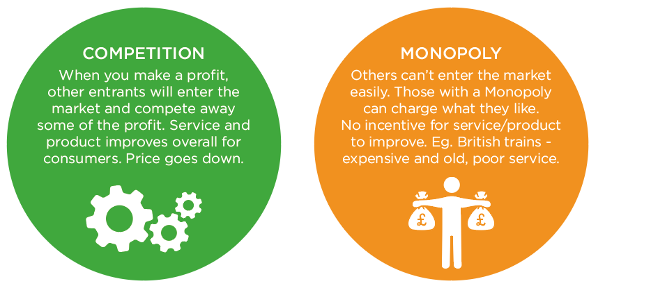
9 Monopolies
Selvin’s comment:: The words are well positioned, but the infographics themselves don’t tell the story in themselves? Not sure about the cog and wheel depiction show how the money bags are distributed
Jo: I will update the icons. My understanding was that this is simply pulling out the provided text (as a table was mentioned). Please confirm if you would like this made into a proper infographic.
Notes:
Difference between monopoly and non-monopoly
Non-Monopoly: When you make a profit, other entrants will enter the market and compete away some of the profit. Service and product improves overall for consumers. Price goes down.
Monopoly: Others can’t enter the market easily. Those with a Monopoly can charge what they like. No incentive for service/product to improve. Eg British trains - expensive and old, poor service.
This could be displayed in a two column table

Slide 15

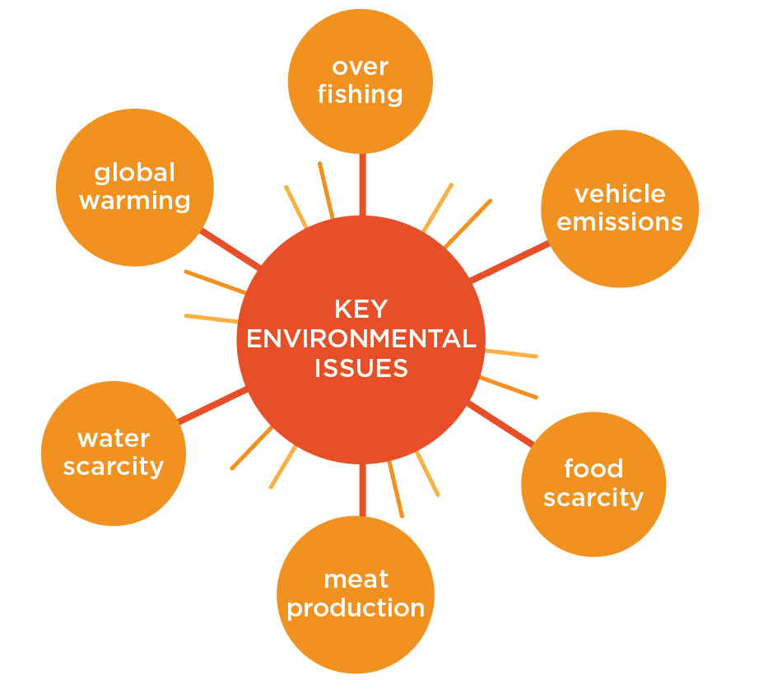
10 Key environmental issues
Selvin’s comment:: Good layout of issues through spider graph but pictorial representation of each issue would add to it and make it conceivable in a glance
Notes:
10. Picture representation of all the key environmental issues (possibly spider graph)
Global Warming
Overfishing
Vehicle emissions
Food scarcity
Environmental cost of meat
Overfishing
Comment: Maybe make more use of pictorial representations. So fishing would have a fish etc. Perhaps put a globe in overall.

Slide 16
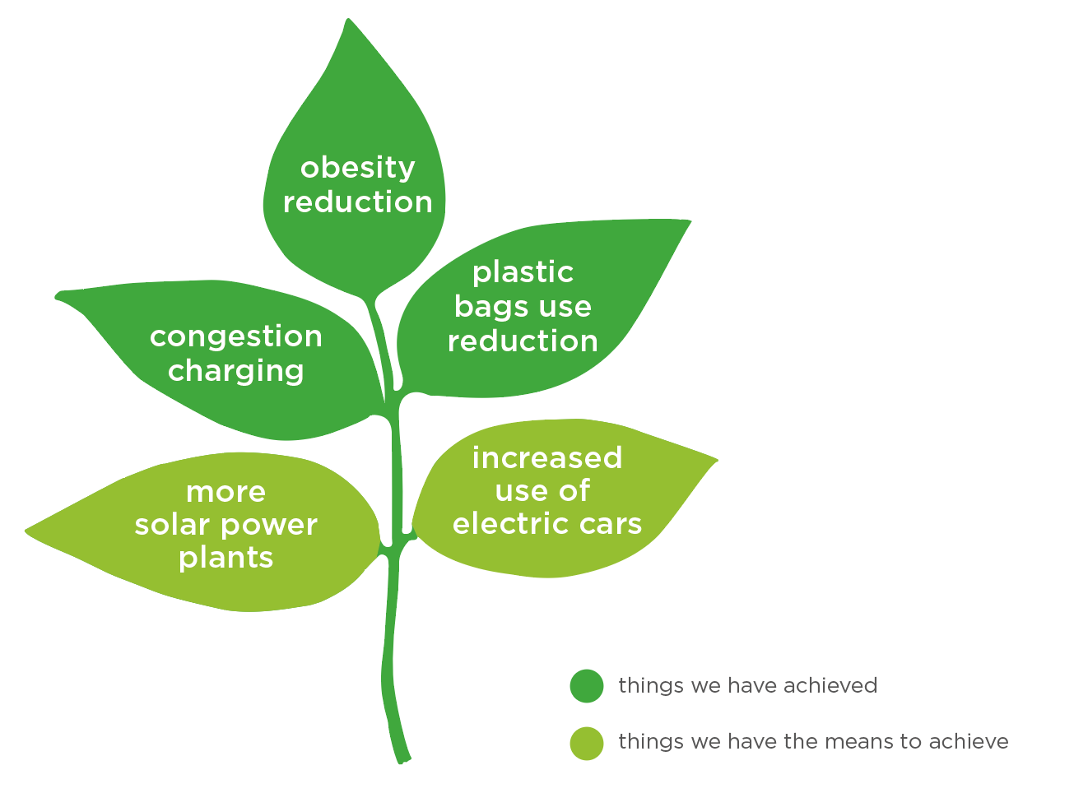
11 Successful environmental initiatives
Selvin’s comment: Nice depiction - I like how the different coloured green leaves depiction and how the lighter new leaves represent emerging initiatives towards a better environment
Work in progress
Notes:
11. Graphic box of successful environmental initiatives - combination of infographics, bullet points, pictures
Congestion charge
Plastic bag charge (list of problems with plastic bags cause)
Obesity
Things we have to means to achieve
Electric cars
Solar Power plants
---------
Good infographic
How have we acheived obesity reduction? It appears to be getting worse.

Slide 17
12 Taxes Affect
Notes:
12. Bads Taxes Affect
Consumer behaviour
Producer behaviour eg a carbon tax will affect the type of energy stations built
Example 1: Sugar tax effects:
Amounts of sugar people can afford and
Amount of sugar put into cheap food such as breakfast cereal
Example 2: Carbon tax effects:
Amount of energy people use in their home
Composition of generation - how much coal or gas is burnt
New investment inelectricity generating capacity whether fossil fuel or nuclear/renewable is built

Slide 18
13 How export/import intensive different industries are
Notes:
13. Image of how export/import intensive different industries are
STEPHEN: Find stern review image.

Slide 19
14 Border tax adjustments for carbon tax
Notes:
14a. Diagram of upstream prodction carbon tax
An upstream carbon tax is one that taxes the underlying fossil fuels as they come into the tax area (country). An upstream carbon tax would tax coal oil and gas as they are extracted from the ground or as they are imported into the country.
Show diagram of oil tanker and gas pipeline coming into the UK and being taxed
14b. Consumption vs production carbon taxes Diagram of border tax adjustments for carbon tax
A production basis carbon tax is one which taxes fossil fuels where it is burnt so for a company producing widgets the tax base is in the country where the products are produced.
A consumption basis carbon tax is one that taxes according to where consumption of goods and services takes place. So in this case, goods produced for export are not taxed in the country of production. Likewise, imported goods are taxed according to their approximate carbon content.
To shift a production carbon tax to a consumption version, we need a border tax adjustment. This is a tax on imports according to the embodied carbon involved in their manufacture and a subsidy to export to cancel out the carbon tax already paid.
Show similar diagram as 14a but with aluminium and steel being taxed on import and subsidised on export

Slide 20
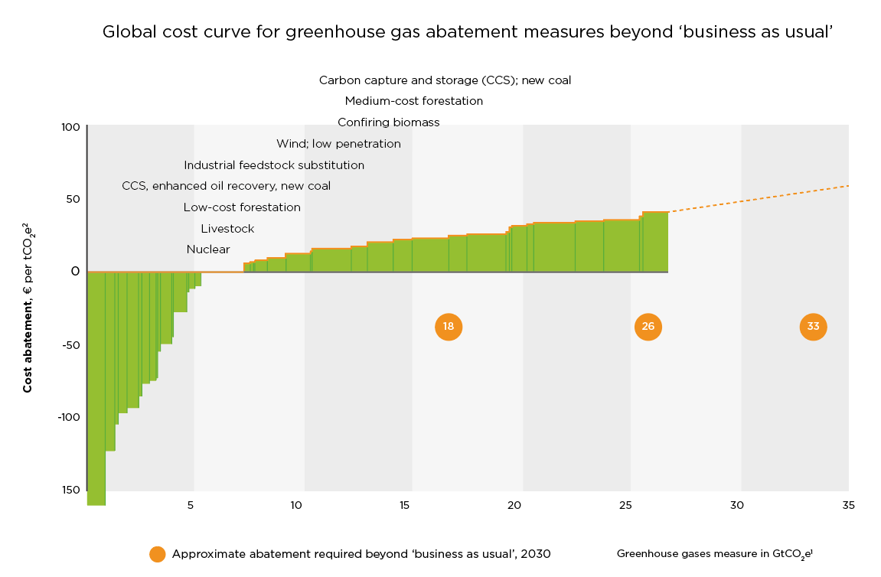
15 How high carbon tax needs to be (McKinsey cost curve)
Selvin’s comment: This is a chart so not sure how easy it would be to understand at a glance. There may be a lighter way to depict how export/import intensive different industries are by creating icons for each type of industries accompanied by a label
Jo: agree this will be much clearer if simplified, and I will do that. Is there any information in the original which can be removed? That would be very helpful.
Work in progress
Notes:
15. Image of How high carbon tax needs to be (McKinsey cost curve)
http://www.mckinsey.com/business-functions/sustainability-and-resource-productivity/our-insights/a-cost-curve-for-greenhouse-gas-reduction
Makme this simpler and use boxes with diagrams to make it work

Slide 21
16 Jobs at Risk of Robotisation infographic
Selvin’s comment: There is another chart showing workers at risk of automisation under section 5.1 What is work?
Economic research council (2017) Chart of the Week: Workers at Risk of Automation by Sector
The chart shows that 30% of UK jobs are considered to be at high risk of automation by the early 2030s.
The chart shows the percentage of automisation that is likely to occur within certain industries - picking out a few to illustrate this trend will create some interest infographics.
For example, an illustration could depict a different colour representing a human and robot and the rough percentage of where the human becomes replaced by the robot body. It could also just be a human hand being taken over with robotic features.
Notes:
16. Jobs at Risk of Robotisation infographic
http://www.thisismoney.co.uk/money/news/article-2642880/Table-700-jobs-reveals-professions-likely-replaced-robots.html

Slide 22
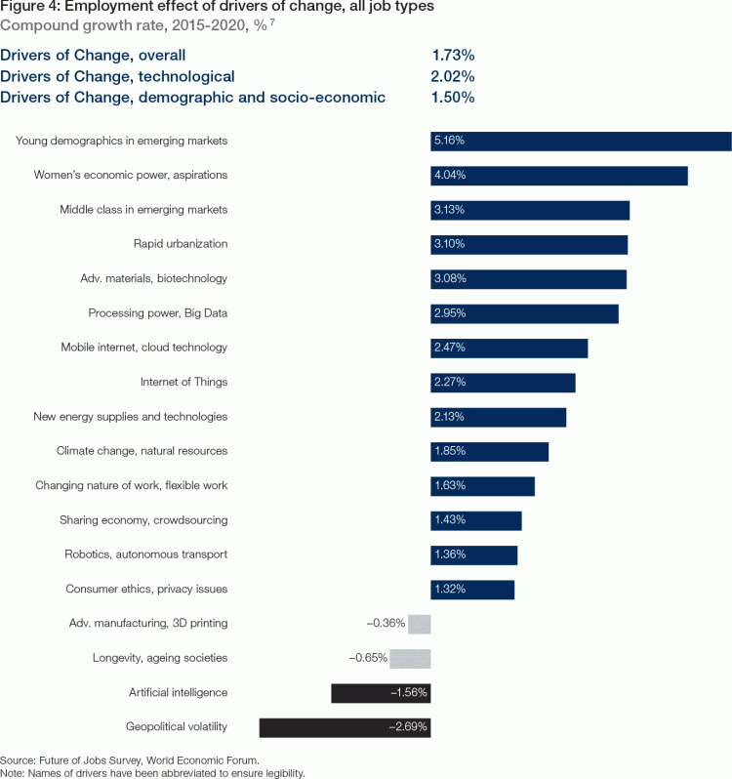
17 Drivers of job losses
Notes:
17. Drivers of job losses
http://reports.weforum.org/future-of-jobs-2016/employment-trends/

Slide 23
18 Poverty Trap
Notes:
18. Poverty Trap
Effective marginal tax rate - the proportion of a small increase in earnings that is lost in tax and withdrawn benefits. High EMTRs amongst workers in low-income families are often referred to as the poverty trap.
Unemployment Trap
replacement rate (out-of-work income as a proportion of in-work income, where income is measured after taxes and benefits) or the participation tax rate (the proportion of gross earnings lost in tax and withdrawn benefits). High numbers of either of these represent weak incentives to be in work; this situation is often referred to as the unemployment trap.
https://www.jrf.org.uk/report/poverty-trade-work-incentives-and-income-redistribution-britain
http://johnhcochrane.blogspot.co.uk/2012/12/benefits-trap-art.html
(perhaps we could do our own version of one of these images)

Slide 24

19 Whack-a-mole
Jo: I like the idea of having problems in the holes… could you suggest some to try? The less the letters the better so the text isn’t too small.
Work in progress
Notes:
19. Redo cartoons in our style? Eg. Whack-a-mole
Should we have the problem in each hole?

Slide 25
20 Progression of land value increase
Notes:
20. Cartoon, showing the progression of land value increase.

Slide 26
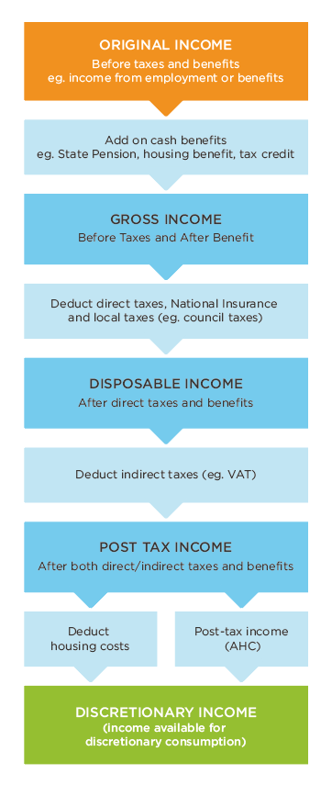
21 Income flow chart
Selvin’s comment:: Good depiction of the sequence in arriving at disposable income but the last 2 text boxes is confusing because Post-tax income (AHC) IS discretionary income. Probably that should be a separate marker similar to a ‘sign here’ tab highlighting the critical point of this diagram, which is that with the high cost of housing, discretionary income can only be considered as money you have after housing cost (AHC).
Notes:
Comment: Perhaps it should be set up as a flow chart, so that
21. This in shaded boxes, in our colour scheme?
Original Income
Before taxes and benefits
Eg income from employment or benefits
↓
Add on cash benefits
eg . State Pension, housing benefit, tax credit
↓
Gross Income
Before Taxes and After Benefits
↓
Deduct direct taxes, National Insurance and local taxes (eg council taxes)
↓
Disposable Income
After direct taxes and benefits
↓
Deduct indirect taxes (eg VAT)
↓
Post tax income
After both direct/indirect taxes and benefits
↓
Deduct housing costs
↓
Post-tax income (AHC)
↓
Discretionary income (income available for discretionary consumption)

